Slide 1
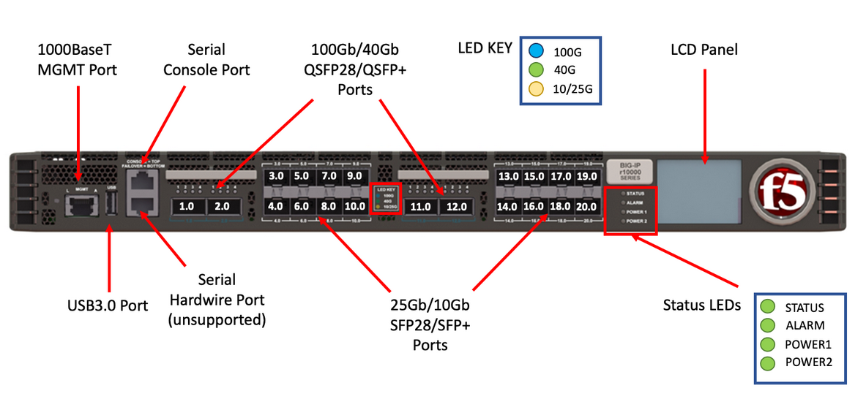
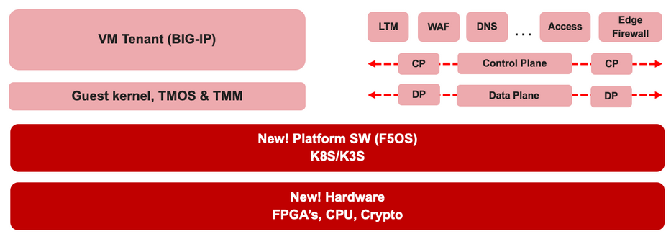

F5 rSeries Learning with
Alexander S

Slide 2
Agenda →
  iSeries to rSeries
  F5OS Basic Setup
  F5OS Upgrade Procedure
  VLAN and LAG Configuration
    Configure VLANs
    Configure LAG (Link Aggregation Group)
    Assign VLANs to the LAG
  Tenant OS Deployment Preparation
  Tenant OS Deployment
  rSeries Tenant Basic Setup
  High Availability (HA) in rSeries Tenants
    Best Practices for rSeries Tenant HA
    rSeries Tenant HA Configuration

Slide 3
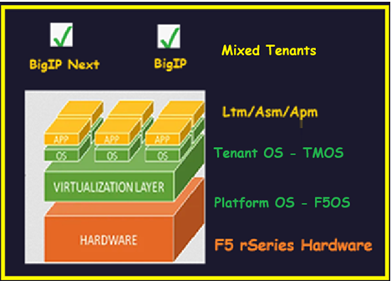
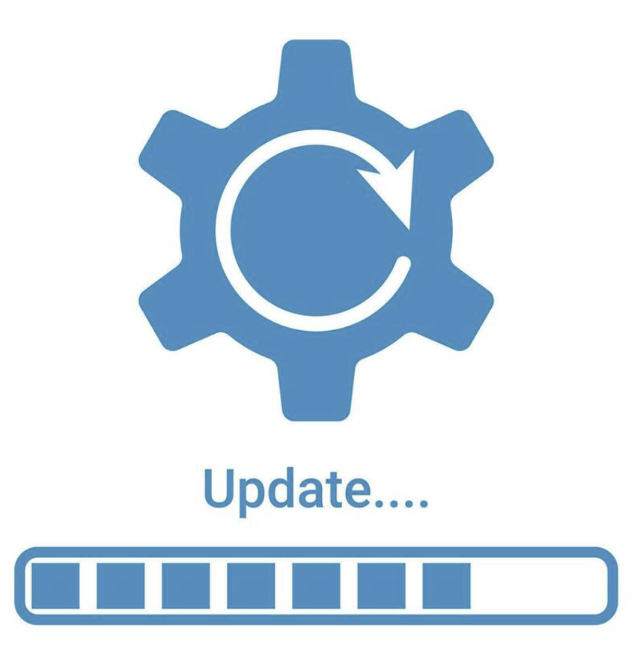
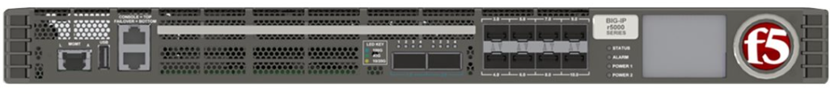
Chapter 3 - rSeries F5OS Upgrade Procedure & import tenant OS for tenant deployment

Slide 4
F5OS Upgrade Procedure – Understanding the F5OS Architecture
(a New Kubernetes based platform layer – Built in with Microservices Based architecture)
The rSeries hardware operates with two layers of operating systems:
  Platform Layer Operating System
  Tenant Layer Operating System
Platform Layer OS – F5OS
  F5OS is the platform layer OS, built on a Kubernetes-based micro services architecture.
  It runs directly on the rSeries bare-metal hardware.
  F5OS virtualizes hardware resources and provides the interface to operate and manage the system.
  Management access to F5OS is available via CLI, Web UI, and REST API.
Tenant Layer OS – BIG-IP
  The tenant OS can be either BIG-IP (TMOS) or BIG-IP Next.
  Each tenant runs in an isolated virtual environment, similar to a virtual machine.
  Tenants are deployed, managed, and monitored through the F5OS platform.

Slide 5
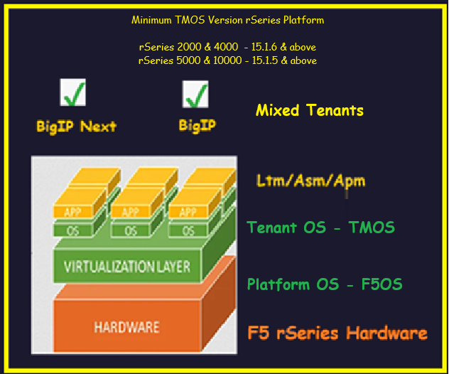



rSeries Platform – Minimum Supported Tenant TMOS Version
Minimum TMOS Version rSeries Platform
  rSeries 2000 & 4000 - 15.1.6 & above
  rSeries 5000 & 10000 - 15.1.5 & above
TMOS version must be 15.1.6 to migrate the configuration

Slide 6
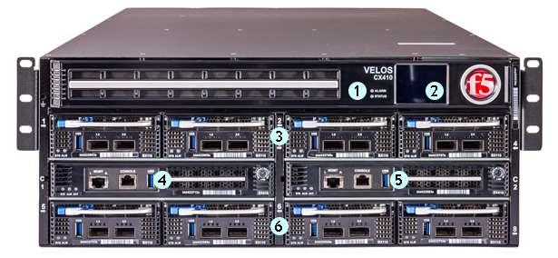
F5OS Versions Based on Hardware Model
  VELOS chassis systems – F5OS C
F5OS is available in two versions, depending on the hardware platform:
  F5OS-A: Designed for rSeries appliances
  F5OS-C: Designed for VELOS chassis systems
  F5OS C – C stands for Chassis
  rSeries Appliances – F5OS A
  F5OS A – A stands for Appliances

Slide 7
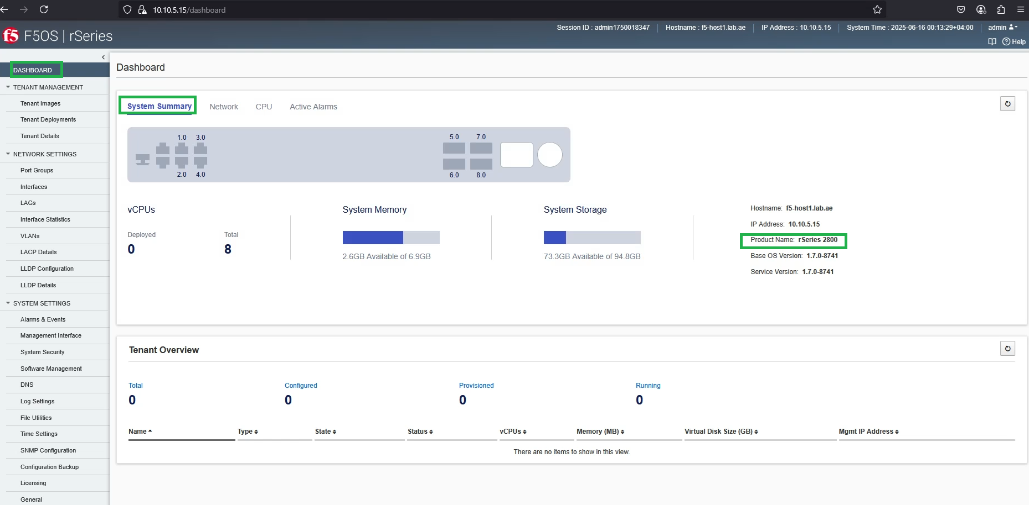
F5OS upgrade – Identify the hardware model
Before You Upgrade
  Identify your hardware model (rSeries or VELOS).
  Our Model is r2800 series hardware.

Slide 8
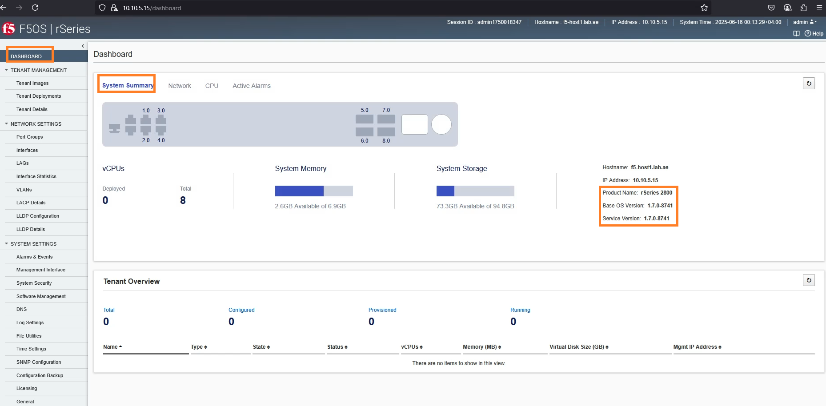
F5OS upgrade – Check the current F5OS Version
Before You Upgrade
  Identify the current running F5OS version.
  Current running version is 1.7.0.8741
  Based on the hardware model and current running F5OS version, download the appropriate F5OS software version from the F5 support portal.

Slide 9

rSeries 2800 Upgrade - Login to F5 website and download F5OS
Login to my.f5.com & sing in
  For the sign in you should have account
  It prompt for OTP & type the OTP and Login
Once you login go to resources & Downloads
Accept the terms and conditions to download
Select the product family, Product Line, Product Version
  Product Family – F5OS
  Product Line – F5OS appliance
  Product Version – F5OS version
Select the iso file based on your hardware and download
  rSeries 2000 & 4000 ISO file
  rSeries 5000, 1000 & 12000 ISO file
  F5OS A - Download

Slide 10
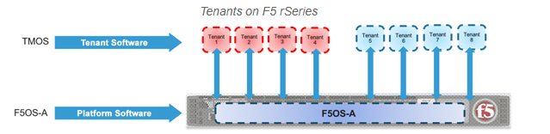
Our scope is not limited to the F5OS upgrade!
We also need to deploy the tenant afterward.
To deploy the tenant, we require the Tenant OS, which is the BIG-IP Virtual Edition (VE).
Let’s proceed to download it.

Slide 11

F5OS Platform - Tenant TMOS download options
    There are four tenant TMOS download options.
    Micro
    Small
    Medium
    Large
    The Micro and Small images include only the base system and support limited BIG-IP functionality (typically LTM and DNS). Additional components are downloaded during deployment.
    Both Medium and Large images support all BIG-IP modules.
    However, the Large image provides more disk space, which is useful for tenants that require heavy logging, database storage, or future scalability.
  TMOS Download

Slide 12
Download - platform-F5OS and Tenant-TMOS
    This is how, we download the platform-F5OS and Tenant-TMOS from the f5 web site.
  TMOS Download
  F5OS A - Download

Slide 13
rSeries 2800 Upgrade
  VELOS chassis systems – F5OS C
We are going to upgrade r2800 appliance
Login to the hardware Check the current F5OS
Login to F5 website and download
    the latest stable F5OS
    the tenant OS for BIG IP
Import the F5OS
Install the new imported F5OS and Reboot the r2800 appliance
Verify the F5OS rSeries appliance version after the system reboot
Import the tenant image
  rSeries Appliances – F5OS A

Slide 14
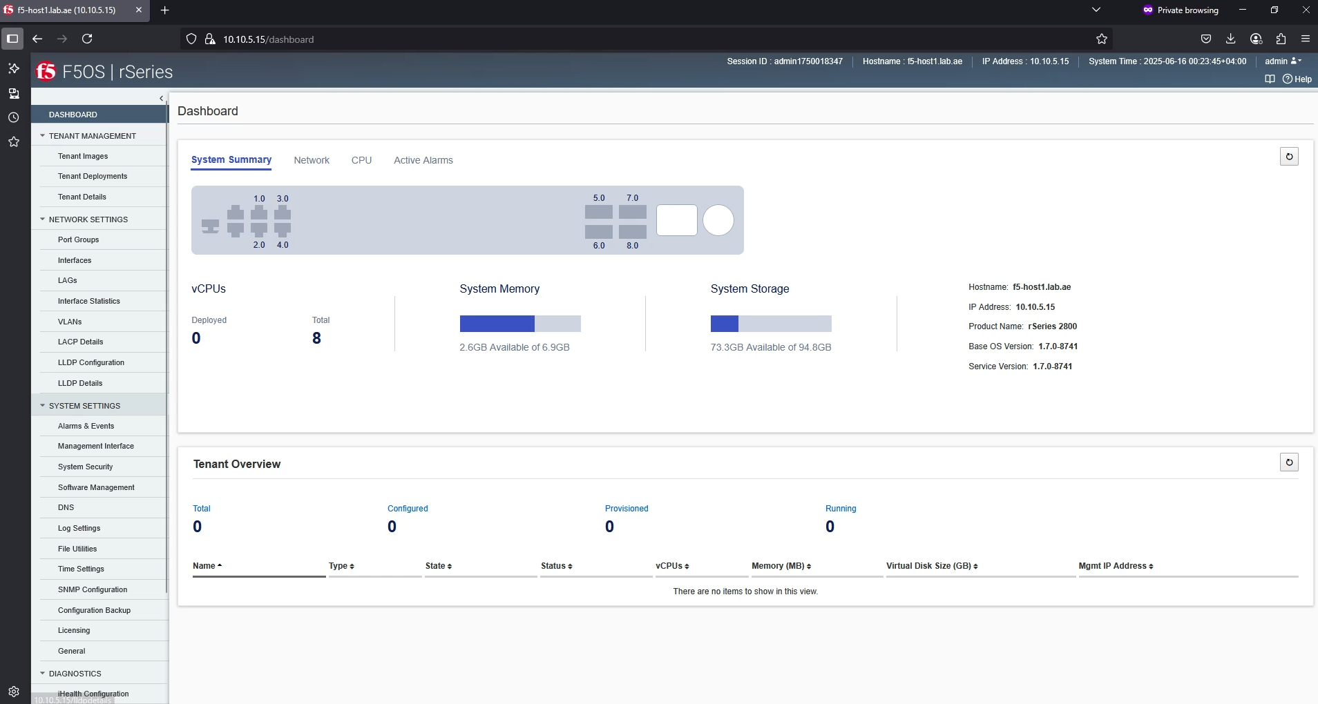
Login to the F5 rSeries Platform

Slide 15
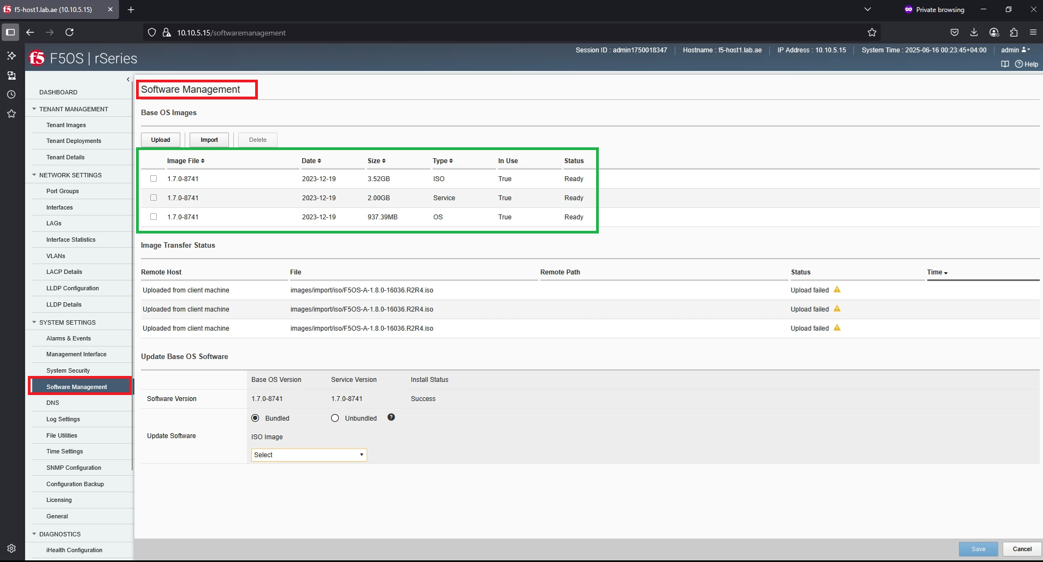
Click Software Management

Slide 16
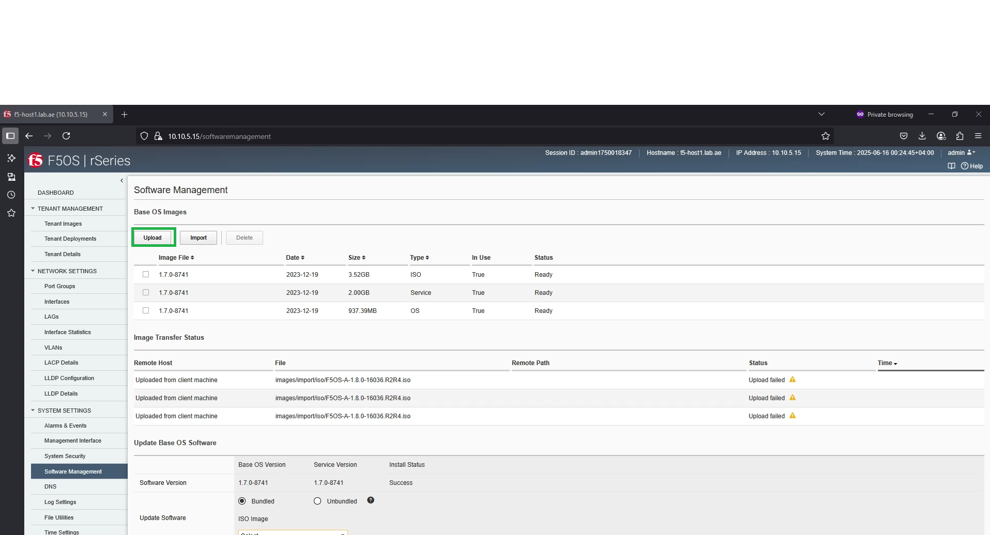
Import the downloaded F5OS Image into rSeries Platform

Slide 17
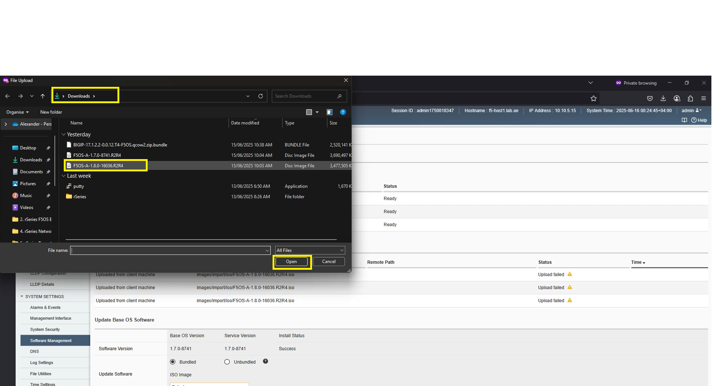
Import the downloaded F5OS Image into rSeries Platform

Slide 18
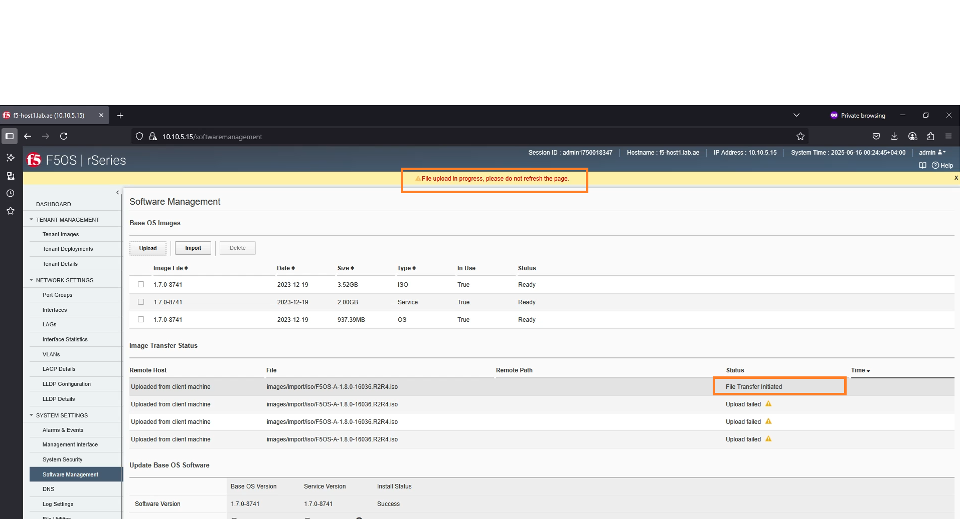
Import the downloaded F5OS Image into rSeries Platform

Slide 19
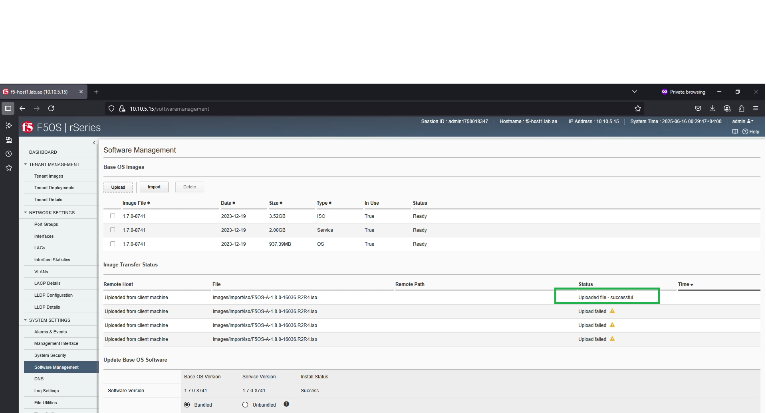
Import the downloaded F5OS Image into rSeries Platform

Slide 20
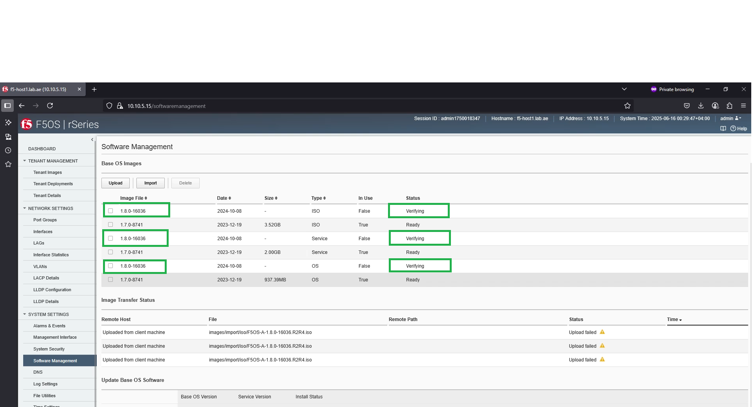
Import the downloaded F5OS Image into rSeries Platform

Slide 21
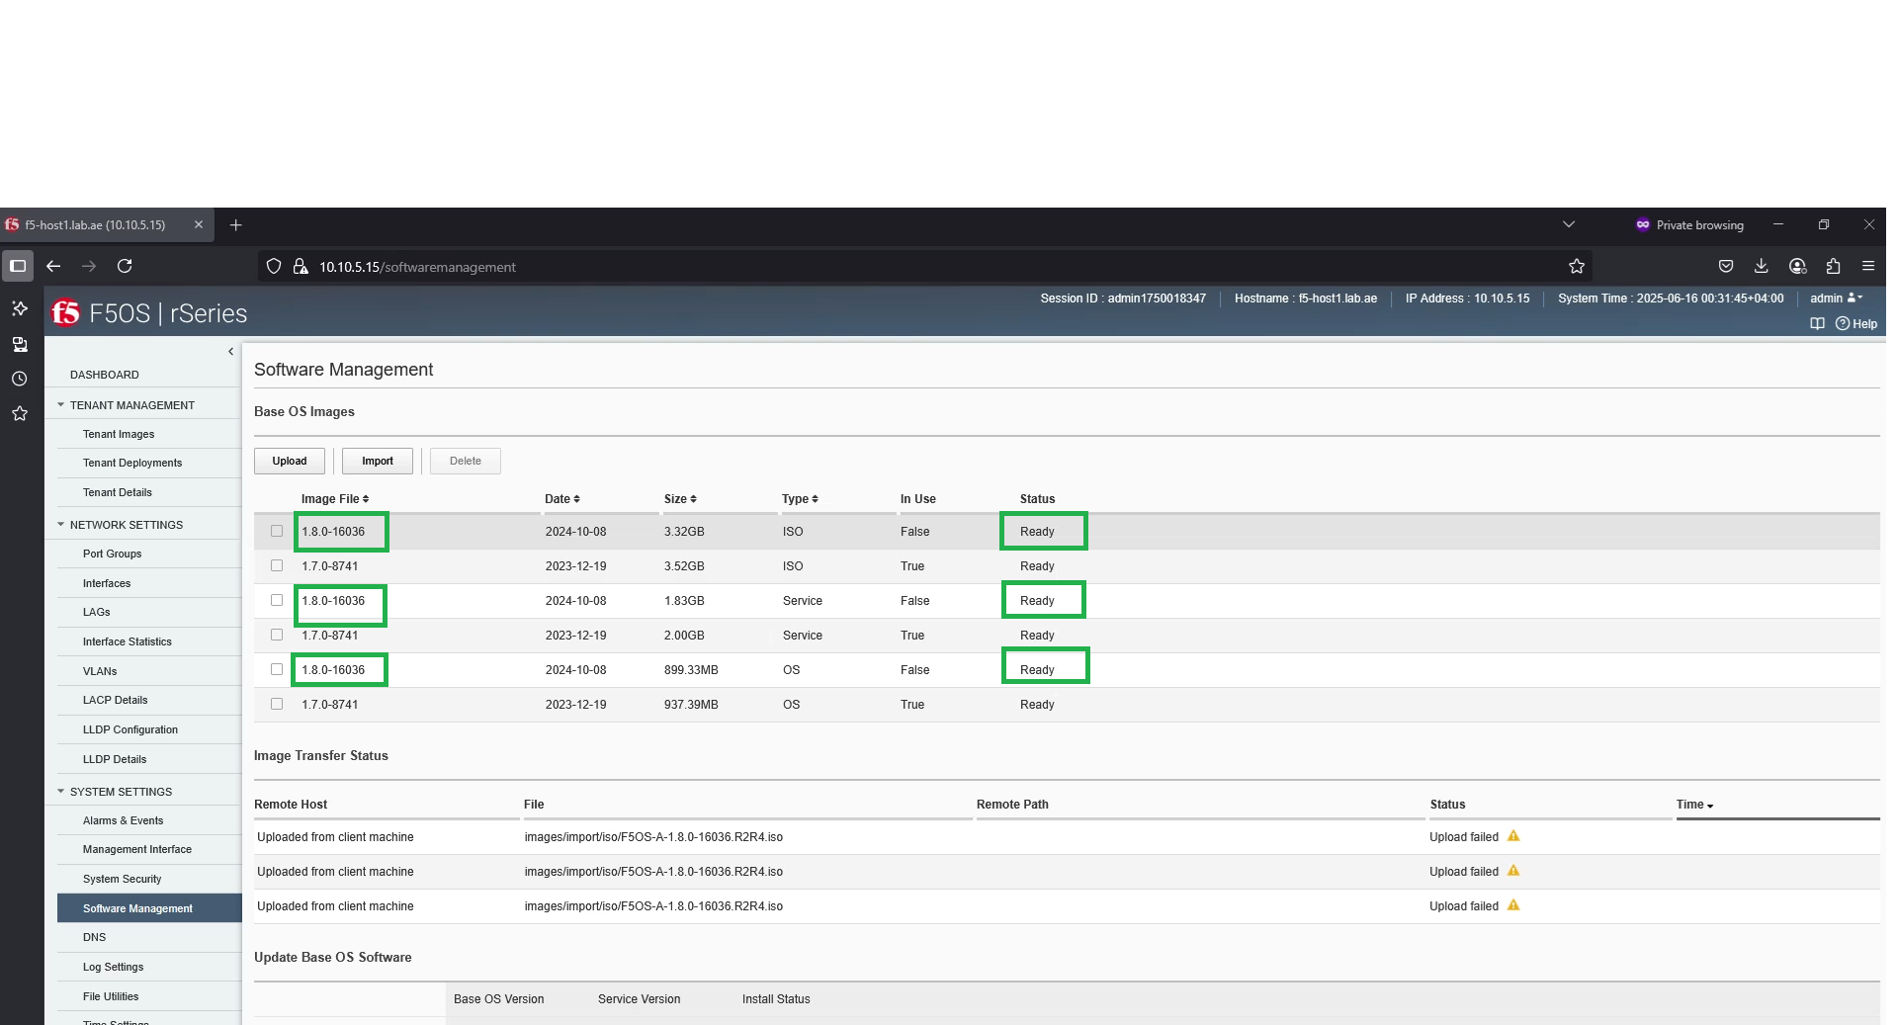
Import the downloaded F5OS Image into rSeries Platform

Slide 22
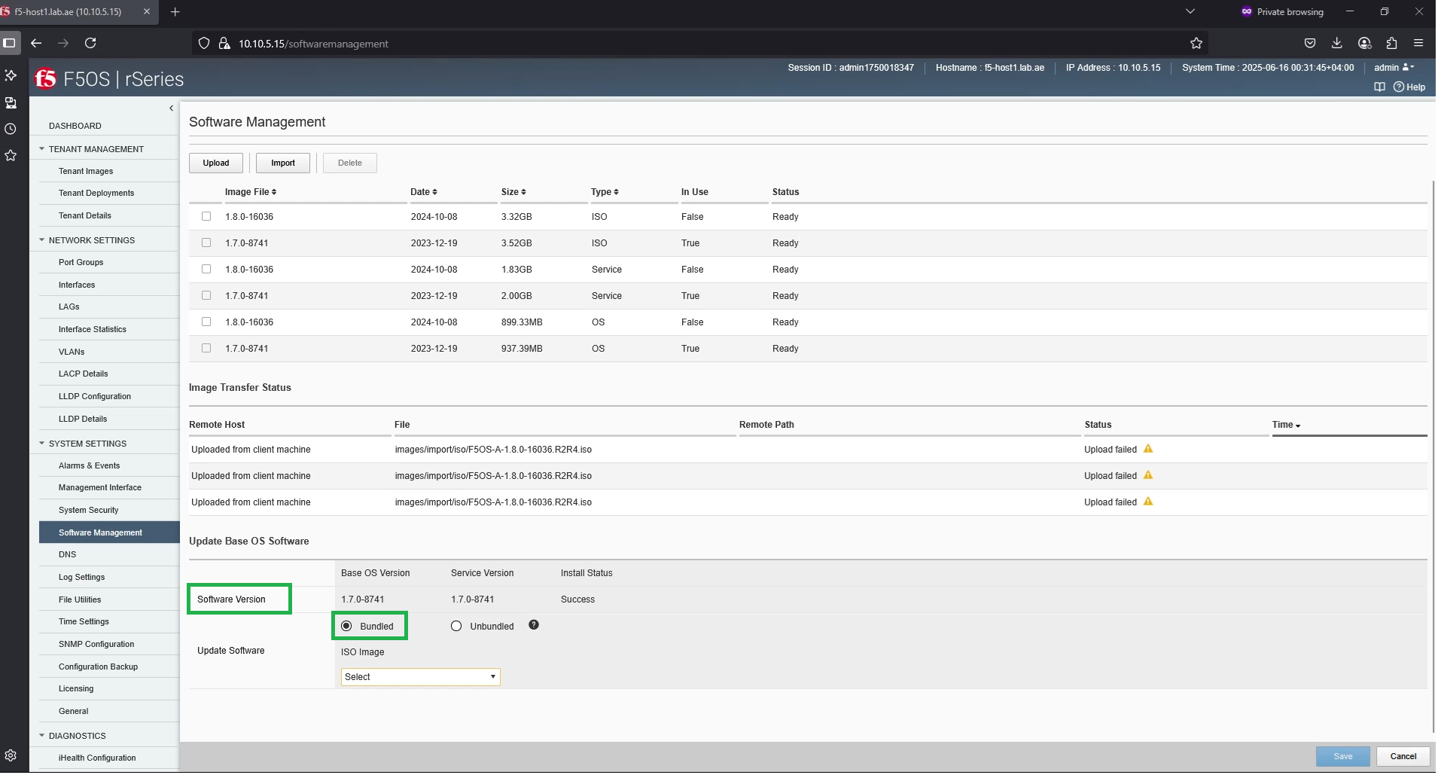
Upgrade the platform OS – F5OS upgrade

Slide 23
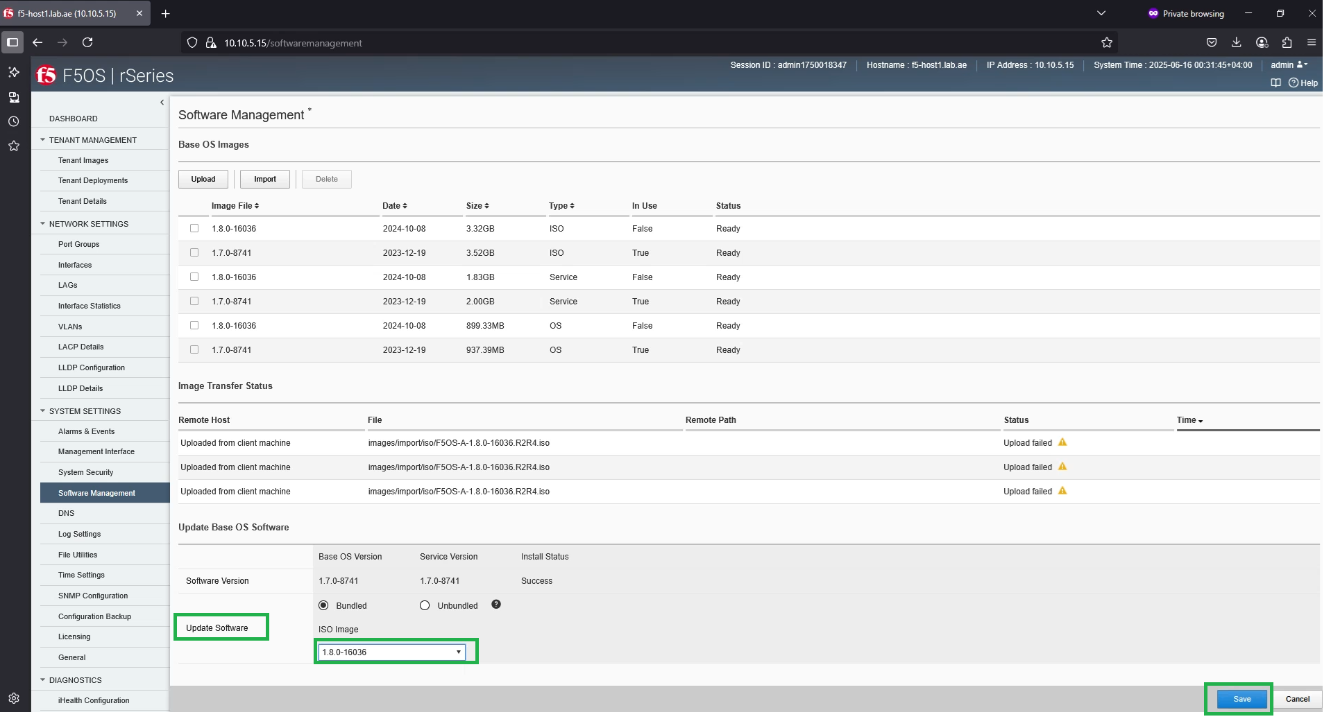
Upgrade the platform OS – F5OS upgrade

Slide 24
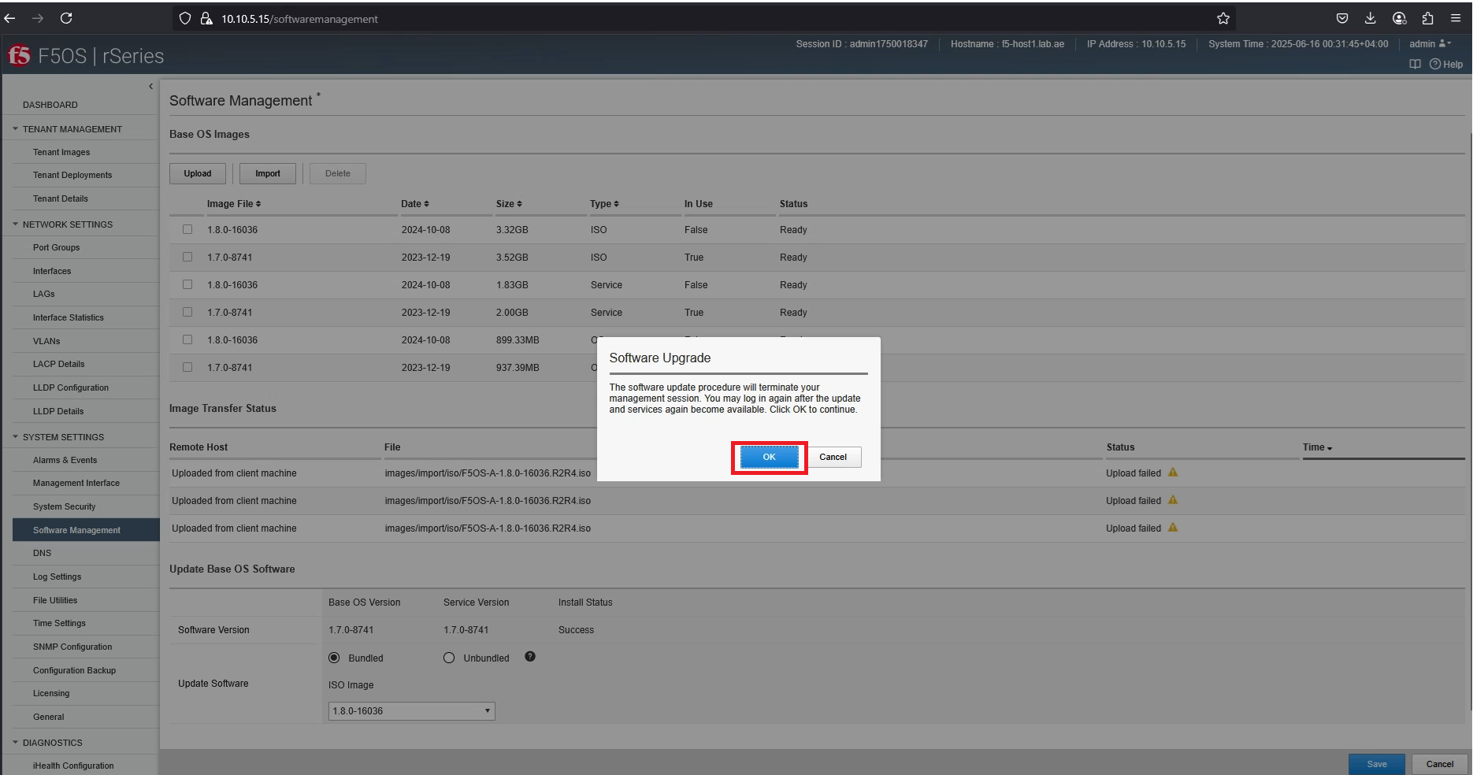
Upgrade the platform OS – F5OS upgrade

Slide 25
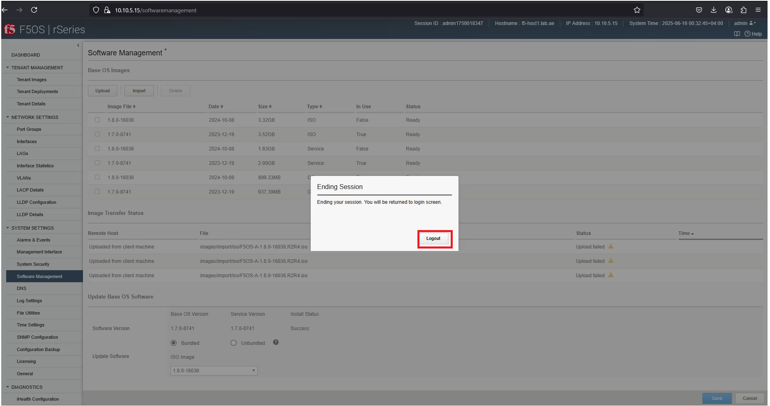
Upgrade the platform OS – F5OS upgrade

Slide 26
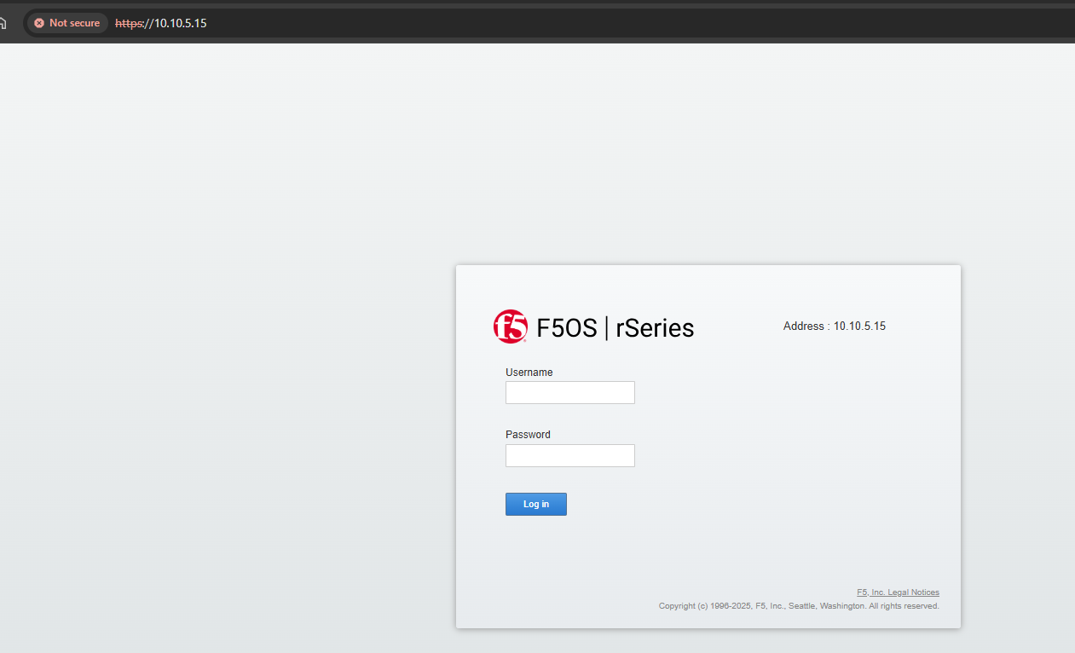
Upgrade the platform OS – F5OS upgrade

Slide 27
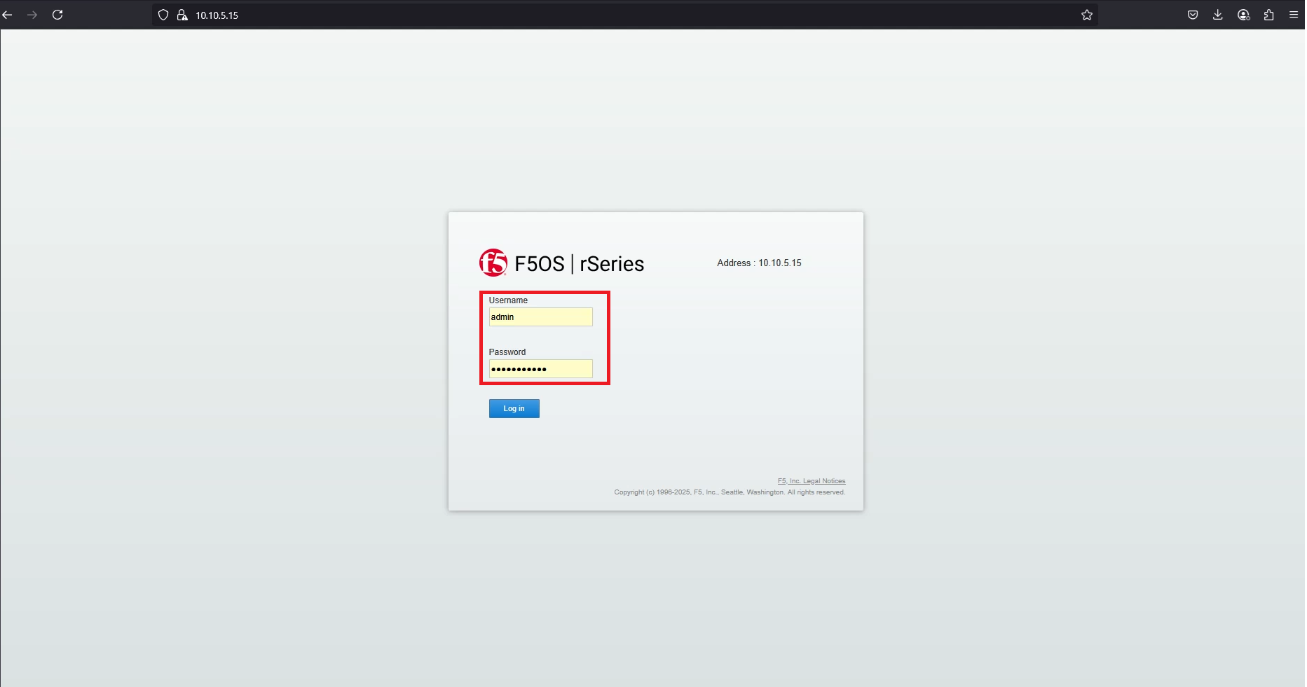
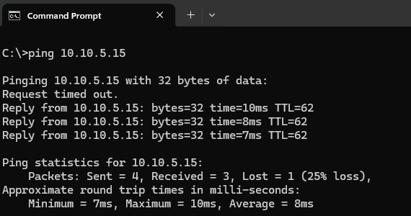
Upgrade the platform OS – F5OS upgrade

Slide 28
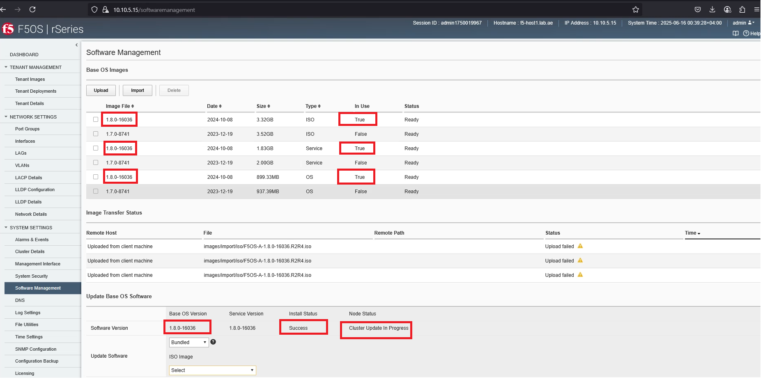
Upgrade the platform OS – F5OS upgrade

Slide 29

rSeries platform F5OS upgrade is successful !!!
(From 1.7.0-8741 to 1.8.0-16036)

Slide 30
Our scope is not limited to the F5OS upgrade!
We also need to deploy the tenant after upgrading F5OS.
To do this, we need the Tenant OS, which is the BIG-IP Virtual Edition (VE) to be imported into the rSeries platform.
Let’s proceed to upload the Tenant OS to the rSeries platform.

Slide 31
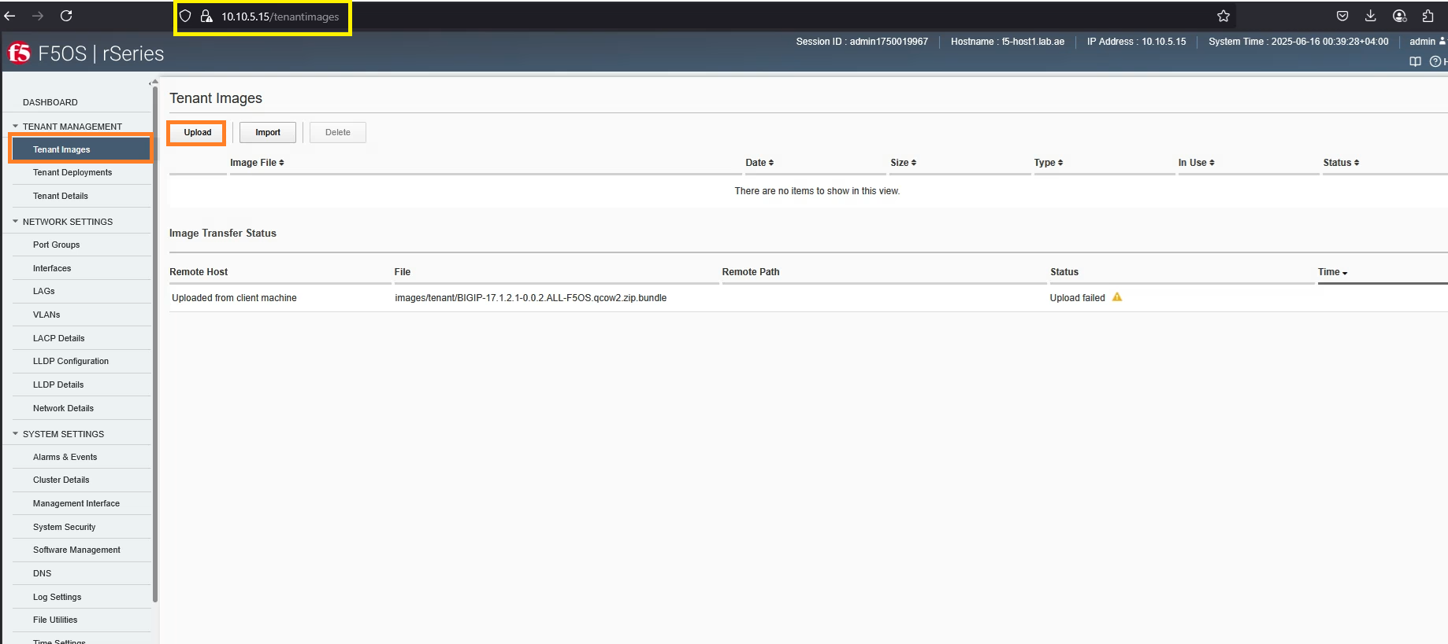
Import the tenant OS to rSeries platform for tenant deployment

Slide 32
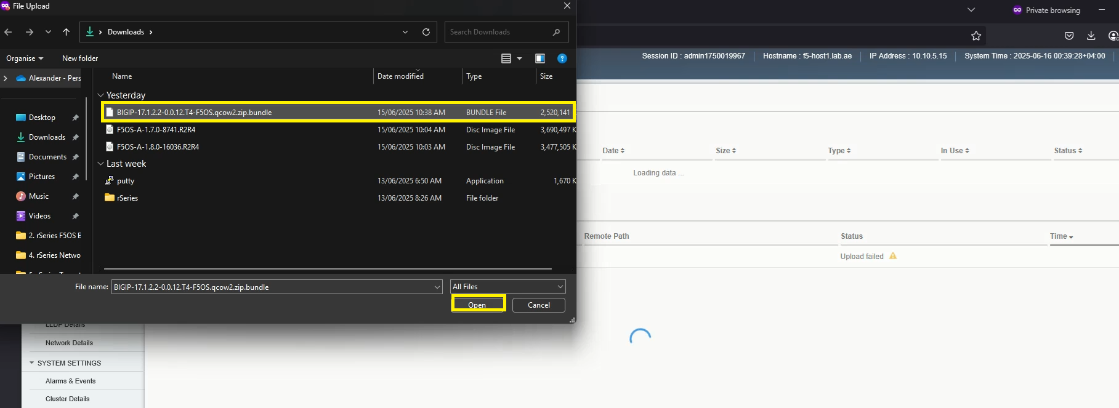
Import the tenant OS to rSeries platform for tenant deployment

Slide 33
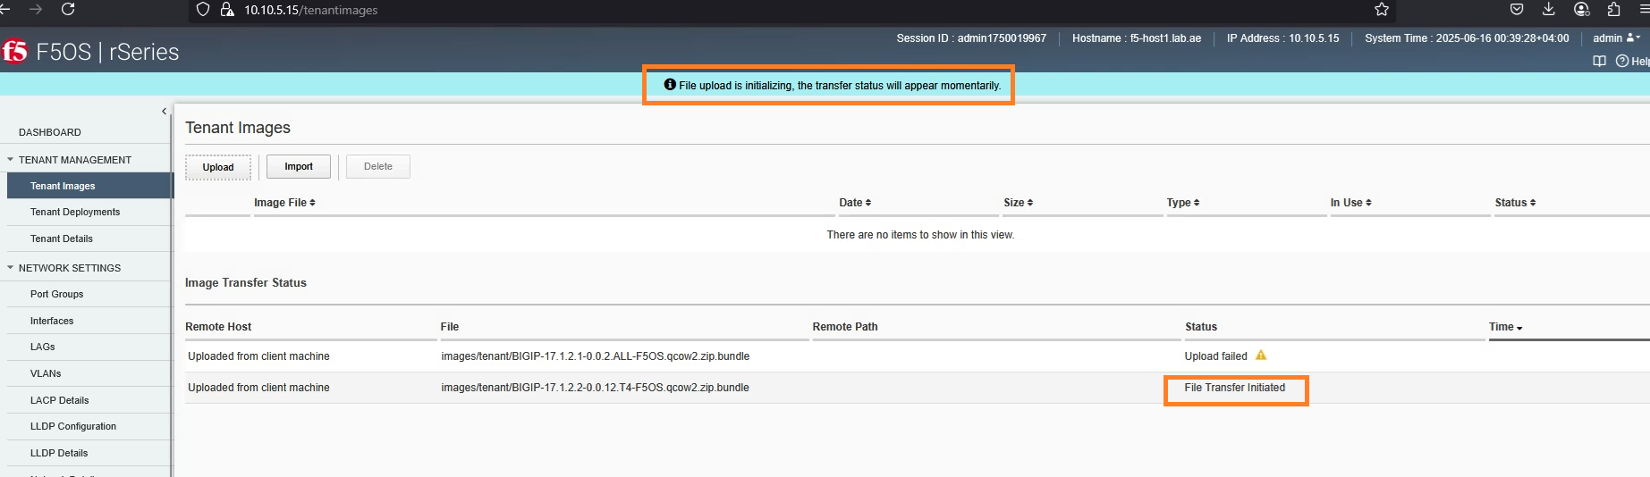
Import the tenant OS to rSeries platform for tenant deployment

Slide 34
Import the tenant OS to rSeries platform for tenant deployment

Slide 35
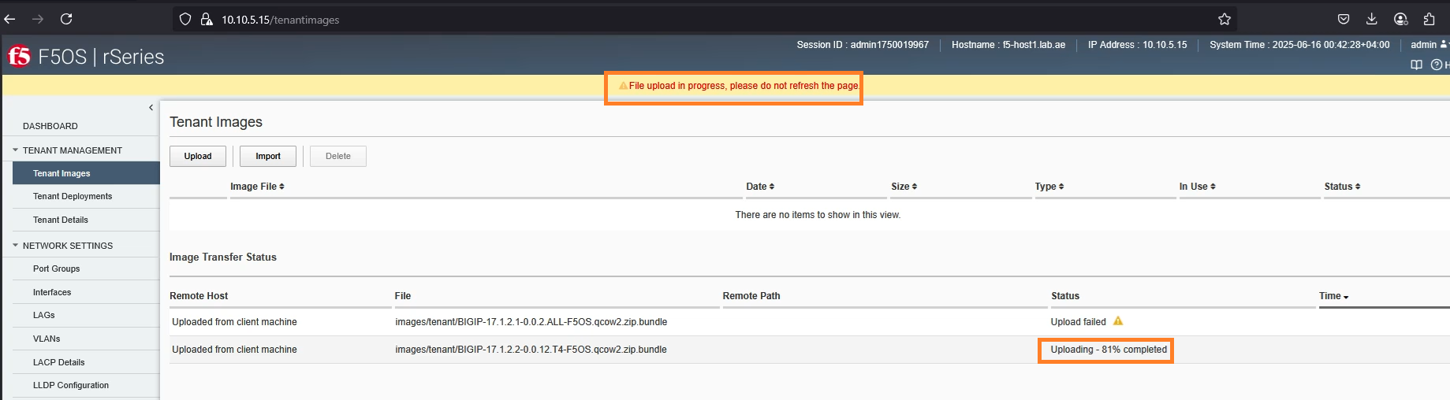
Import the tenant OS to rSeries platform for tenant deployment

Slide 36
Import the tenant OS to rSeries platform for tenant deployment

Slide 37
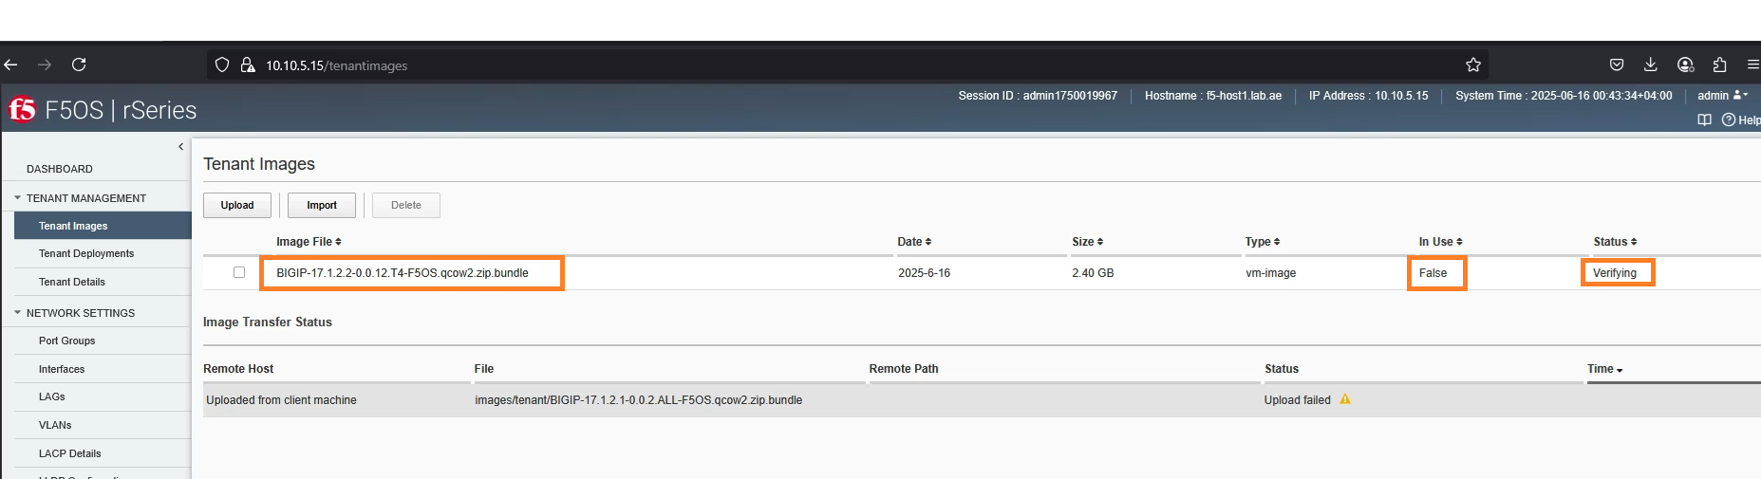
Import the tenant OS to rSeries platform for tenant deployment

Slide 38
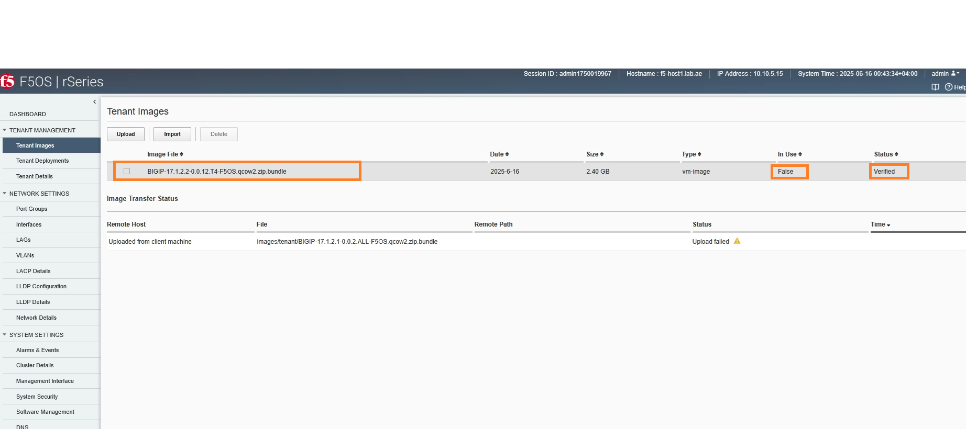
Import the tenant OS to rSeries platform for tenant deployment

Slide 39
Tenant OS is imported to rSeries platform successfully !!!

Slide 40
In this video,
we have successfully completed the F5OS upgrade in our rSeries platform
We have imported tenant OS in rSeries platform for the new tenant deployment.

Slide 41
Please continue by watching the next video.
Next video is – rSeries Networking – Thank you!!!
(VLAN and LAG Configuration)

